Slide 1
Secure Data hiding in images using steganography
CAPSTONE PROJECT
Presented By: Sidhra Sameer Shaikh
Student Name : Sidhra Sameer Shaikh
College Name & Department : Poona Institute of Management Sciences and Entrepreneurship, MBA-HRD Department

Slide 2
OUTLINE
Problem Statement
Technology used
Wow factor
End users
Result
Conclusion
Git-hub Link
Future scope

Slide 3
Problem Statement
Data Protection is always compromised while sharing data or information and has high risk of being manipulated when not encrypted.
Data Protection is an important and crucial component while sharing information. Steganography is the art and science of embedding secret message in the cover message which can be used to protect data by hiding it in images or by encryption and decryption methods.

Slide 4
Technology used
In this Project, I have used Python 3.13 (64 bit), cv2 libraries, os libraries, string libraries.
Also it is important to have a device either laptop or computer with an updated version of Microsoft Windows (Probably windows 10) with good internet connection.
For execution of the code used in this project it is necessary to install cv2 libraries which can be installed by pasting the code pip install cv2 in the command prompt of the computer or laptop.

Slide 5
Wow factors
In this project I have used Python which is used on a large scale for many different software and application developments so it is necessary to have a good hold on this Python Language.
When the code is executed or run it displays a a text “Enter the secret Message” and on entering the secret message it shows another text “Enter the passcode” which is basically the password or the encryption key.
On entering the passcode, an encrypted image appears which has the secret message hidden in it. After that a text appears which asks for the decryption passcode and on entering the decryption passcode, the secret message comes on the screen.
This project is a simple example of encryption, decryption and how steganography uses these components to hide data and secure and protect the data or information.
This project is also a very good example of Symmetric Encryption where one pass key is used for both encryption and decryption.
Also this project can be great example of Advanced Encryption Standard (AES).

Slide 6
End users
The End users are the Multinational Companies or the organizations who want to protect their data and secure their confidential information.
The End Users can also be the customers or suppliers where the organization would have to share some important financial information or personal Confidential Information.
Also the banks and financial institutions can be the end users of this project as steganography will help them to protect the details of financial transactions , hide the confidential information and protect the data.
Many retailers and also small business enterprises can use this to safeguard their inventory details, customer and supply chain details. This steganography model can help them to protect data against data manipulation, replication and exploitation.
Lastly but the most important end users are the Government and Army agencies who can be the end users of this project as they can share secret messages which can help in national security and maintaining peace cross the borders. They can use this technology to encrypt and decrypt messages and hide important messages in images or cover files.

Slide 7
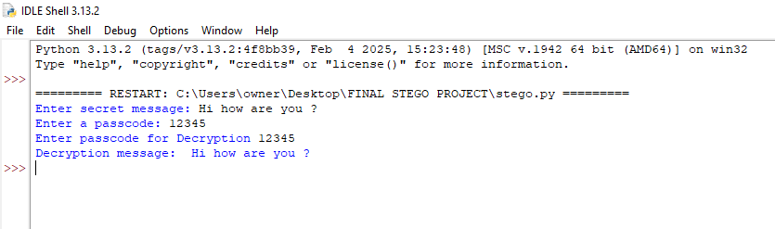
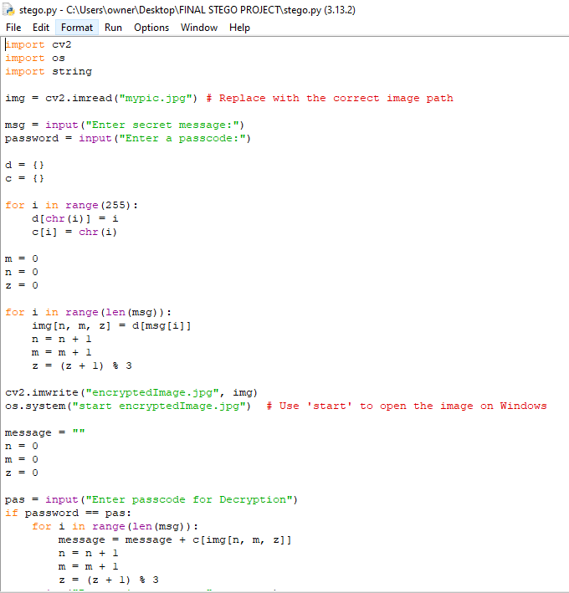

Results

Slide 8
Conclusion
This project is very useful in data protection and helps in avoiding manipulation of confidential information. Hence I Conclude that this project can be used to protect data and securely share confidential information amongst businesses, customers and suppliers. Also it would be beneficial to tackle and mitigate certain risks like data manipulation, data replication and data exploitation. It can be a helpful source for sharing confidential information and data which can help the businesses to freely share the data without any discrepancies and risks while sharing.
Not only this, but this project also signifies the importance of steganography in the real world business challenges and how it can help many retailers, healthcare entities, businesses, and multinational companies to combat the problems related to confidential data sharing, data protection and security and data exploitation,etc.

Slide 9
GitHub Link
Please check this Git hub link for my project code and other details:
https://github.com/Sidhra03/Steganography-project-AICTE.git

Slide 10
Future scope(optional)
The future scope of this project s that it can be used to make other students aware of this steganography model.
Also this project can be used by many different IT professional as a base to create a Graphical User Interface (GUI).
This project can be taken up by different businesses for protecting and sharing information in a more protected and secure way as this steganography project uses encryption and decryption that too with data hiding in image.
This project can be very useful in many ways as it can help end number of users like customers, financial institutions, government and army.

Slide 11
THANK YOU

